Slide 1
TECH CRUSH
UrbanNest Health Analytics
HEALTH SECTOR CAPSTONE PROJECT
Predicting Insurance Charges with Linear Regression
Group 6
Notes:
Introduce Group 6 and the project: a Linear Regression model to predict insurance charges for UrbanNest Health Analytics.

Slide 2

Problem To Solve:
UrbanNest prices insurance using rough assumptions, not data.
Result: some patients overpay while others underpay.
This damages customer trust and company profitability.
Our task: build a Linear Regression model that predicts charges from patient attributes, so pricing is accurate, explainable and fair.
Notes:
Why accurate prediction matters: fairer premiums, better customer trust, and healthier margins for the insurer.

Slide 3
The Data We Worked With
1,338
Medical Cost Personal Dataset
Each row is one policy holder, with the insurance charge they were billed.
Predictors: age, sex, BMI, children, smoker, region
Target: charges ($)
Engineered for EDA & SQL: BMI category (WHO bands) and age group
Raw patient records, 7 columns
1,337
Records after removing 1 duplicate row
0
Missing values in any column
Notes:
1,338 raw rows, 1 duplicate (row index 581) removed, no missing values. Cleaned file exported for SQL Server as insurance_cleaned.csv.

Slide 4
Our Workflow
Five steps from raw data to business insight
1
2
3
4
5
Inspect
Clean
Explore
Model
Evaluate
Shape, data types, missing values, duplicates
Dropped 1 duplicate; added BMI and age groups
Univariate, bivariate and multivariate EDA, plus SQL queries
One-hot encoding, 80/20 split, Linear Regression
R², MAE, RMSE and residual diagnostics
Goal: replace rough pricing assumptions with a transparent, data-driven model.
Notes:
Walk through the workflow. Python for cleaning, EDA and modelling; SQL Server for the business questions.

Slide 5
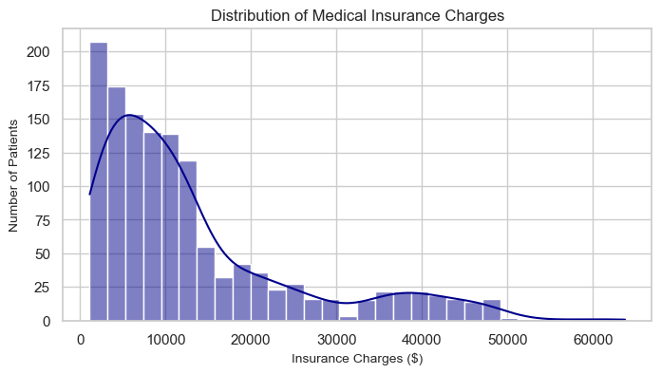
Charges Are Right-Skewed
$9,386
Median charge
$13,279
Mean charge, pulled up by outliers
What it means: most patients pay under $10,000, but a small high-cost group (up to $63,770) forms secondary clusters near $20K and $40K. These are distinct risk groups.
Notes:
Mean is above median because a few very expensive patients pull the average up. Peaks near $20K and $40K hint at sub-populations, which the smoker analysis explains.

Slide 6
Who Are the Policyholders?
Univariate EDA across 1,337 patients
20%
30.7
50.5 / 49.5
are smokers (274 patients), a small group with a big impact
male and female split, so little sex imbalance
mean BMI, right at the obesity threshold of 30
42%
27%
18-64
have no children; only 3% have 4 or 5
live in the Southeast, the largest region; the others sit near 24% each
age range, with a spike of young adults aged 18-20
Notes:
The customer base is balanced by sex and region. Smokers are only 20% of customers, yet we will see they drive costs.

Slide 7
Smoking Is the Biggest Cost Driver
3.8×
Smokers pay 3.8 times more on average
$23,610
Average gap per patient (SQL Q1b)
What it means: the two groups barely overlap. Even the cheapest smoker ($12,829) costs more than the typical non-smoker ($7,346 median).
Notes:
Smoker mean $32,050 vs non-smoker $8,441. Correlation with charges is 0.79, the strongest of any feature.

Slide 8
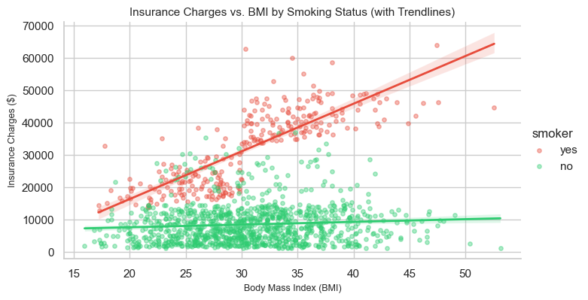
Smoking + Obesity Is Double Risk
$41,558
Avg charge, obese smokers (SQL Q7)
Non-smokers: charges stay low and flat across BMI.
Smokers: charges jump sharply once BMI passes 30.
What it means: the two risks compound. All of the top 10 most expensive patients are smokers with BMI above 30, which is the group wellness programs should target.
Notes:
The widening gap after BMI 30 is an interaction effect. A plain linear model cannot fully capture it, which we revisit in the limitations.

Slide 9
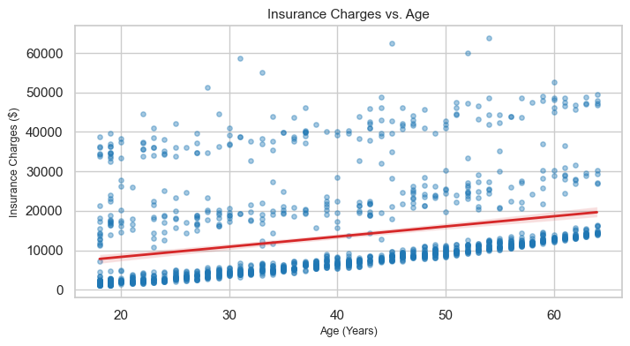
Age, Region and Sex
Age: charges climb steadily with age; the 56-64 group is the costliest.
Region: Southeast is slightly higher.
Sex: median charge is almost identical ($9.4K); men average more only because of a few high-cost outliers.
Notes:
Age has a clear positive slope with three visible bands. Region and sex effects are small compared with smoking.

Slide 10
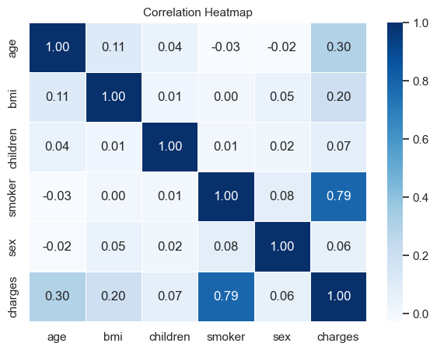
What Moves With Charges?
0.79
Smoker vs charges: strongest link
0.30
Age vs charges: moderate
0.20
BMI vs charges: weak alone
Notes:
Predictors are only weakly correlated with each other (e.g. age vs BMI 0.11), so each contributes independent signal. Low multicollinearity suits linear regression.

Slide 11
SQL Analysis: Business Questions
3.8×
Smokers vs non-smokers
Average charge $32,050 vs $8,441
56-64
Costliest age group
Charges rise with age; ages 56-64 highest
Obese
Effect of BMI category
Obese is the largest group and pays the most
$41,558
Obese smokers (Q7)
Costliest subgroup by a wide margin
2 of 4
Regions averaging > $13K
Southeast first, then Northeast (HAVING)
Notes:
Queries were run in SQL Server (InsuranceDB). Techniques shown: GROUP BY, CASE, window function (pct of top group), WHERE, HAVING, TOP. Also: 385 patients aged 50+ average $17,903.

Slide 12
Preparing the Model
X and y
Why split the data?
y = charges. X = 8 columns: age, BMI, children, sex, smoker and 3 region dummies.
We test on patients the model has never seen.
If it only scored well on training data, it might just be memorizing.
The test score shows whether it learned real patterns that carry over to new customers.
Encoding
Text columns became 0/1 with one-hot encoding. drop_first=True avoids the dummy-variable trap.
Split
80% train (1,069 patients), 20% test (268), random_state=42 for reproducibility.
Notes:
Train-test split is essential for an honest estimate of how the model performs on new patients.

Slide 13
Model Performance on Test Data
Explains about 81% of the variation in charges
0.81
R²
$4,177
MAE
Typical prediction is off by about $4,177
Larger because big misses count more; signals outliers
$5,956
RMSE
Verdict: strong for a simple linear model on real healthcare data. What lowers the score: extreme smoker cases, non-linear effects, limited features and a small sample.
Notes:
R² of 0.81 is good but not perfect. MAE is the easiest metric to explain to business: roughly $4K error per patient on average.

Slide 14
What the Model Learned
Effect on predicted charge, holding other factors constant
Smoker: adds about $23,078 to the predicted charge.
Age: about $248 more per year.
BMI: about $319 more per unit.
Children: about $533 per child.
Sex and region: small effects, so weak pricing factors.
Notes:
Regions are measured against Northeast, sex against female. Intercept is -$11,093 (only a mathematical baseline).

Slide 15
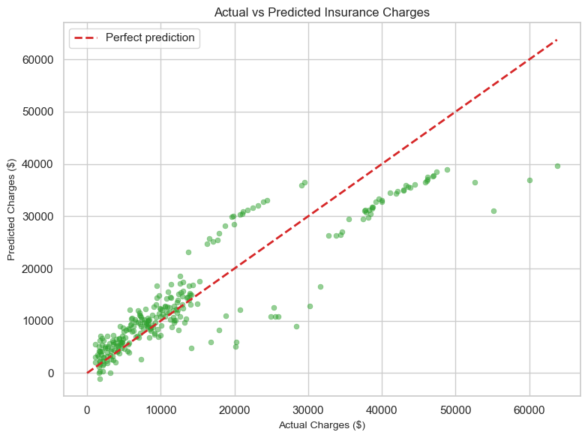
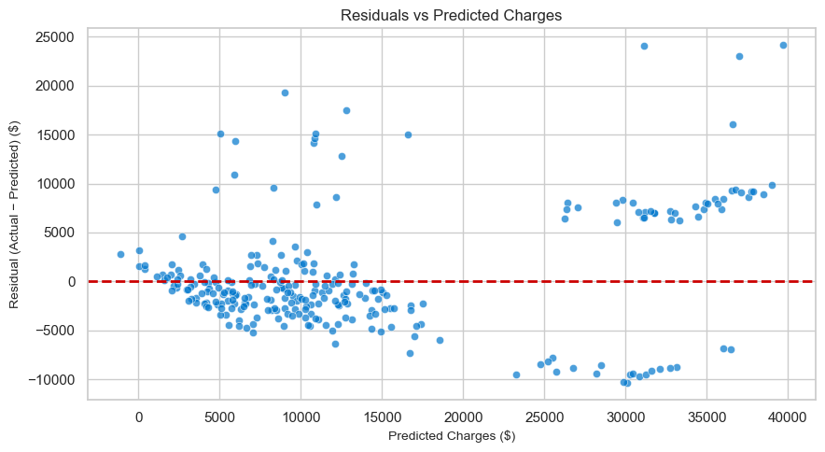
Checking the Model Visually
Actual vs predicted: tight along the diagonal below about $17K; the costliest patients (> $31K) are under-predicted.
Residuals: centred near zero but fan out at high charges, so the model is less accurate for expensive smokers.
Notes:
Mean residual is about $425 with a standard deviation of about $5,941.

Slide 16
Limitations
Under-predicts the costliest
Linear by design
Patients above about $31K, mostly obese smokers, are underestimated.
It cannot capture the smoker × BMI interaction or cost thresholds.
Limited features
Small sample
No medical history or pre-existing conditions in the data.
Only 1,337 patients, so extreme cases are thinly represented.
Notes:
Be honest about limits: these point directly to next steps (interaction terms, non-linear models, richer data).

Slide 17

Recommendations
Price on smoking status first. It is the biggest cost driver by far.
Adjust for age and BMI. Use them as secondary factors.
Target wellness programs at obese smokers, the costliest subgroup.
Keep region and sex out of primary pricing. Their effects are small, so using them risks unfair premiums.
Keep improving the model: add a smoker × BMI term and clinical history data.
Notes:
Recommendations flow directly from the model coefficients and the SQL findings on obese smokers.

Slide 18

THANK YOU
TECH CRUSH
UrbanNest Health Analytics
Group 6 | Health Sector Capstone Project
Notes:
Open the floor for questions.

